Slide 1

Data-Driven Sales Excellence from Insights to Action
Where complex numbers meet clear decisions.
Presented by:Asmaa Shaban
Nada Mohamed
Mohmed yamany

Slide 2

AGENDA
Executive Sales Overview (C-Level)
Operational Sales Performance
Strategic KPI Tracking & Targets
Advanced Time-Intelligence Analysis
Regional & Global Sales Drill-down
Future Delivery Forecast Analysis
Category & Promotion Insights
Data Security & Access Control (RLS)
Recommendations & Future Actions

Slide 3



Executive Sales Overview (C-Level)
Uncovering the stories hidden in sales data to drive smarter, faster business decisions.
$8,341M
$4,789M
57.4%
Total Sales
Total Profit
Profit Margin%
$3,552M
37M
$97M
Total Cost
Total Quantity
Total Returns

Slide 4
⛰️ Problem Statement
The business lacks a unified view that connects high-level financial KPIs with daily sales operations while maintaining data security and role-based access.

Slide 5
🚫 Out of Scope
This assessment focuses on sales and marketing analysis; it does not include supply chain logistics, real-time inventory tracking, or external market competitor data.

Slide 6
📉 Measuring Impact
Success is measured by reducing decision-making time through automated KPI tracking, improving data security via RLS, and enabling 100% visibility into promotion performance.

Slide 7
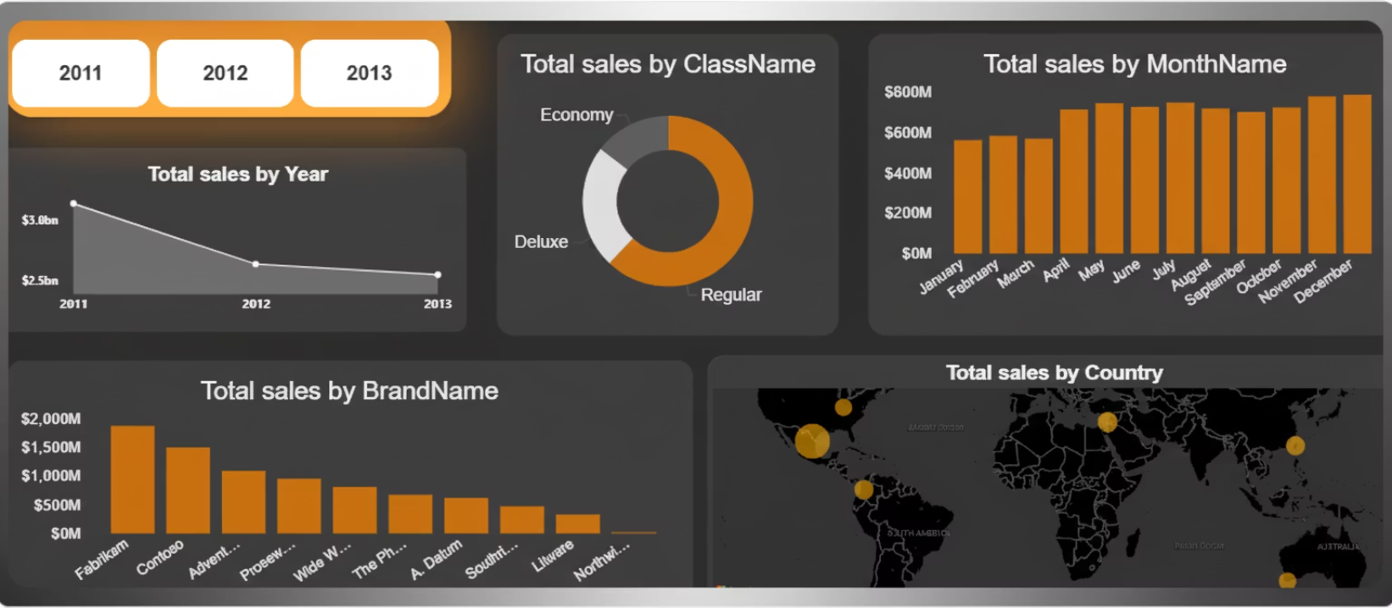
Operational Sales Performance
Core Objective:
To provide a comprehensive real-time overview of global sales distribution and trends, enabling data-driven decisions across product classes, brands, and geographic regions.
Key Insights & Visuals
Temporal Trends
Monitor annual sales trajectories (2011–2013) and monthly seasonality to identify peak performance periods and growth patterns.
Product Segmentation
Breakdown of sales by ClassName (Regular, Deluxe, Economy) to understand the contribution of different product tiers to total revenue.
Brand Authority
Business Value
A competitive ranking of Total Sales by BrandName, highlighting top-performing brands like Fabrikam and Contoso.
Operational Efficiency
Identifies underperforming months or brands to allow for targeted marketing interventions.
Geographic Reach
Strategic Allocation
Interactive global map visualizing sales volume by country, pinpointing high-density market clusters across North America, Europe, and Australia.
Helps in optimizing inventory and resources based on regional demand and preferred product classes.

Slide 8

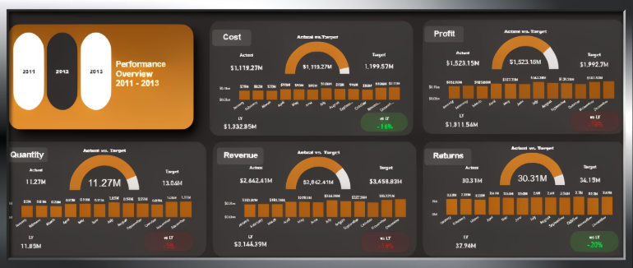
Strategic KPI Tracking & Targets
A comprehensive Strategic Scorecard monitoring 5 core KPIs. Each metric integrates real-time performance vs. target, YTD comparisons, and historical trends to ensure data-driven executive alignment.

Slide 9
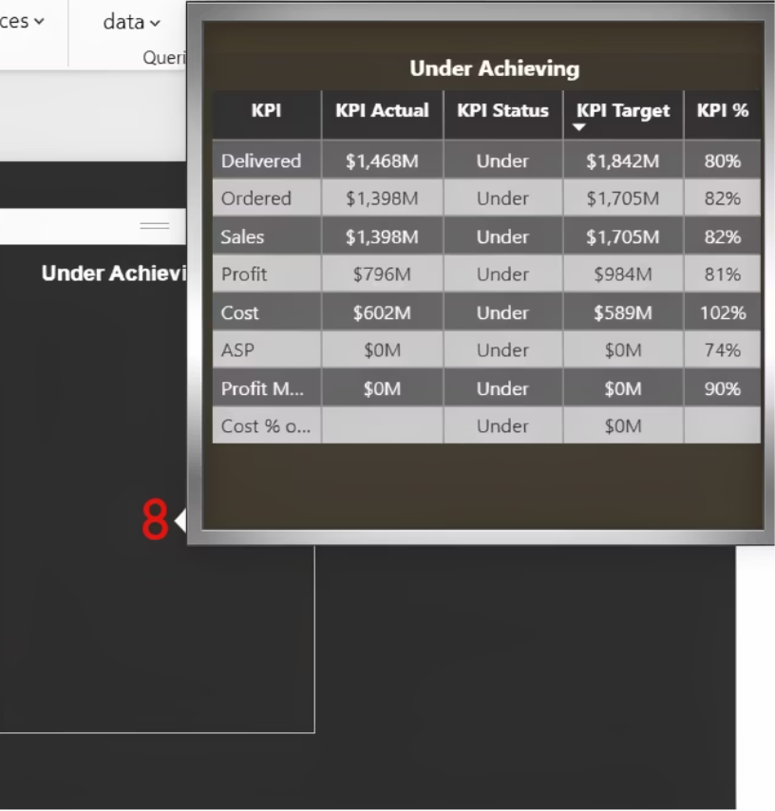
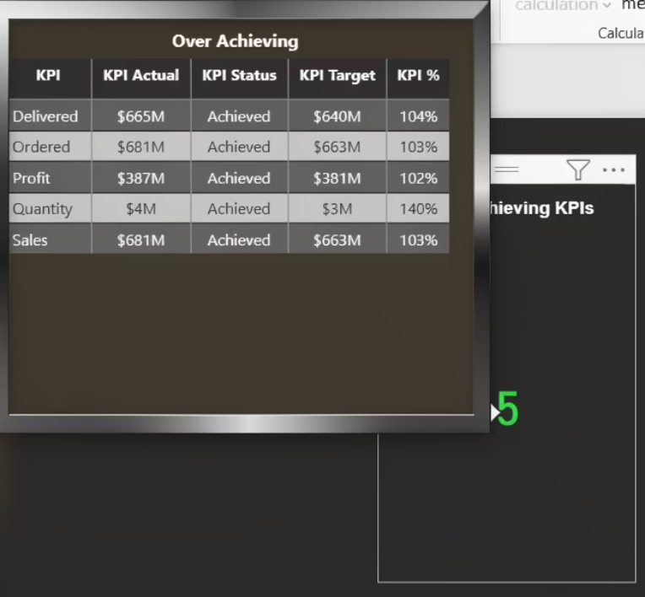
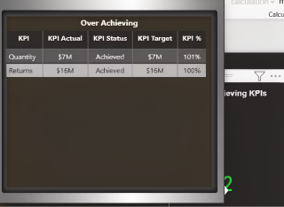
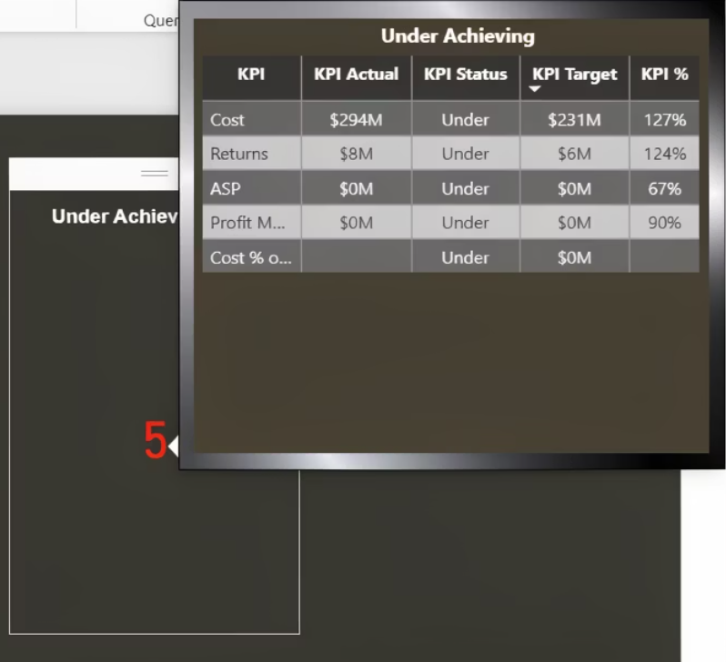
Strategic KPI Tracking & Targets
This analysis compares KPI performance between Asia and North America in 2013 to determine whether underperformance is region-specific or companywide. While North America achieved only 2 out of 10 KPIs, Asia achieved 5 KPIs, showing a significantly stronger performance balance.
North American (2013)
Asia (2013)

Slide 10
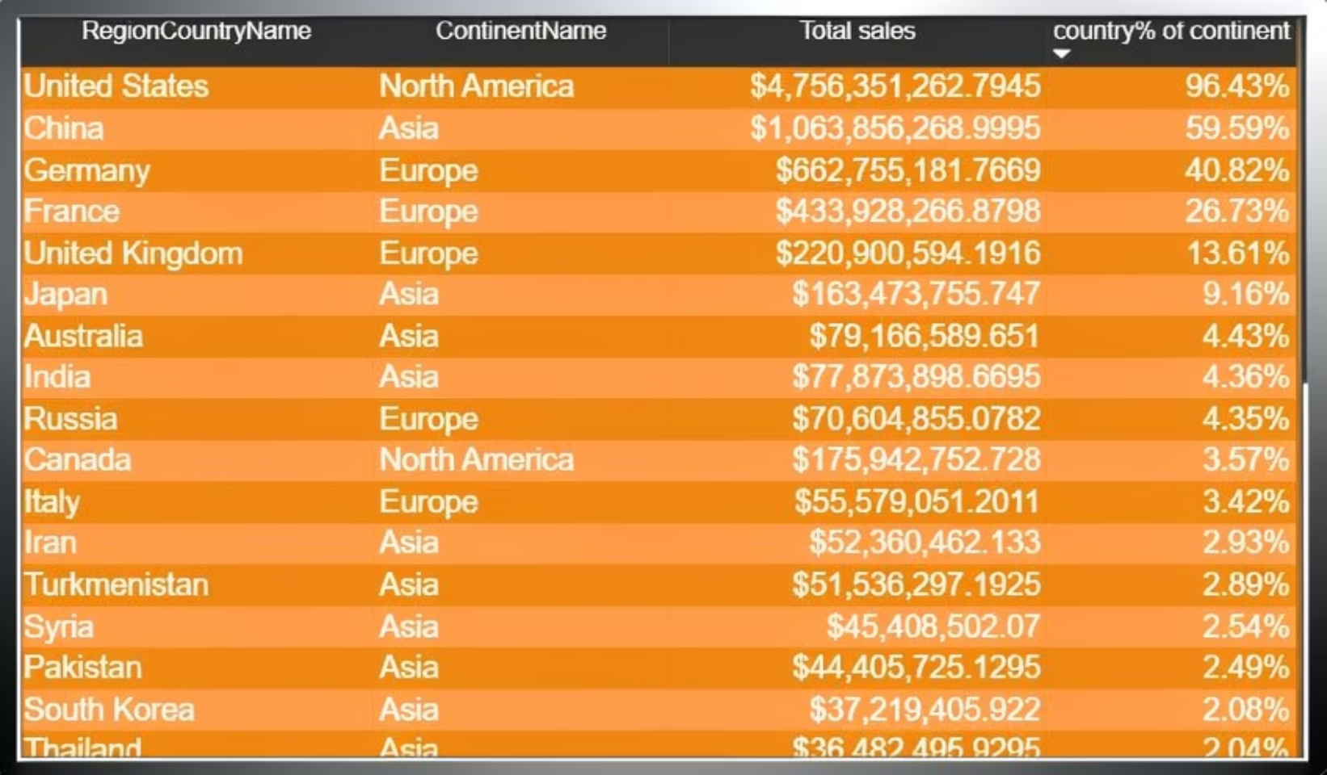
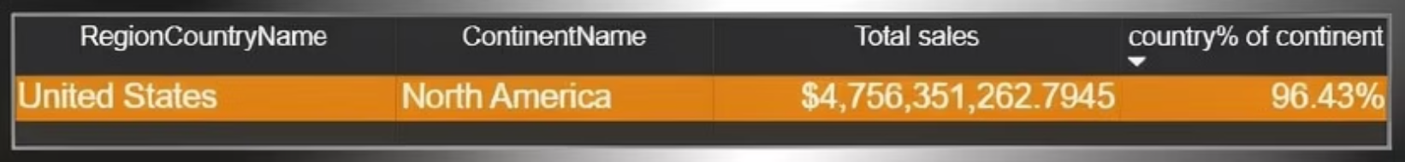
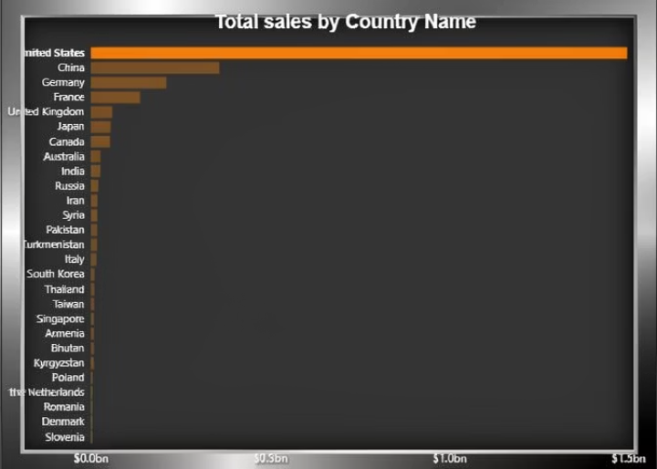

Regional & Global Sales Drill-Down
Country sales calculated the country’s percentage of continent sales by keeping the continent total independent from the country slicer. So, when a country is selected: The country sales change normally but the continent total stays constant That’s why the percentage does not change when selecting a country.
Drill through created a new page that includes Year and Month slicers along with a chart analyzing sales by country. We then implemented the Drill Through functionality, allowing users to right-click on any country and navigate to a dedicated page that shows the historical sales performance of that country across previous years, regardless of the year selected on the main page. This enables deeper historical analysis for each country.

Slide 11

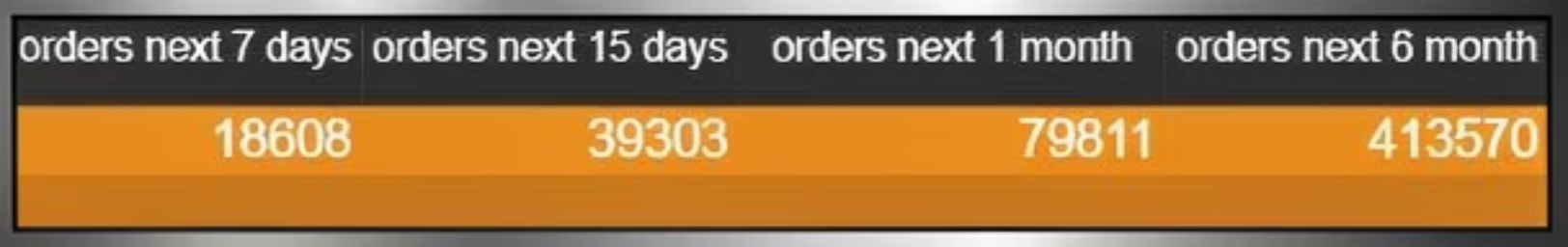
Future Delivery Forecast Analysis
Delivery Orders Analysis created a single-select Date slicer to allow the user to choose a specific day. Then, we built four measures to calculate the number of orders scheduled for delivery within the next 7 days, 15 days, 1 month, and 6 months starting from the selected date. The calculation is based on the Delivery_Date column, not the Order Date. To avoid the active relationship between the Date table and Order Date, we used REMOVEFILTERS('Date') inside CALCULATE. For day-based calculations (7 and 15 days), we added days directly to the selected date. For month-based calculations (1 and 6 months), we used the EDATE function to correctly handle month differences. Finally, we displayed the results in a column chart to compare the number of upcoming deliveries for each time.

Slide 12
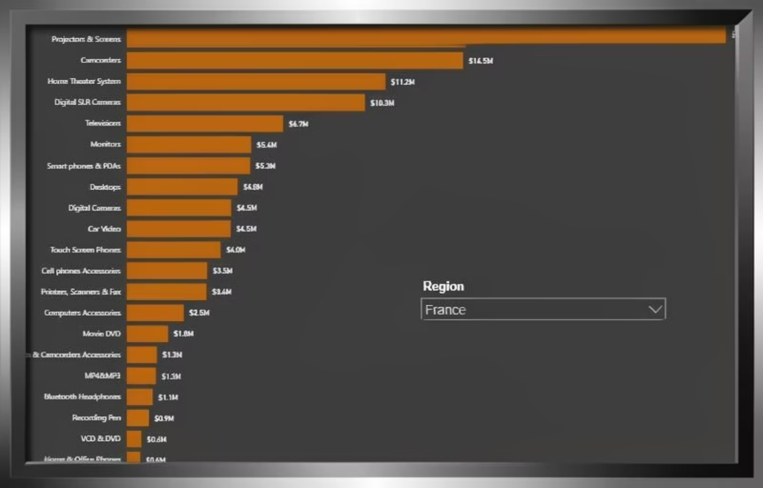
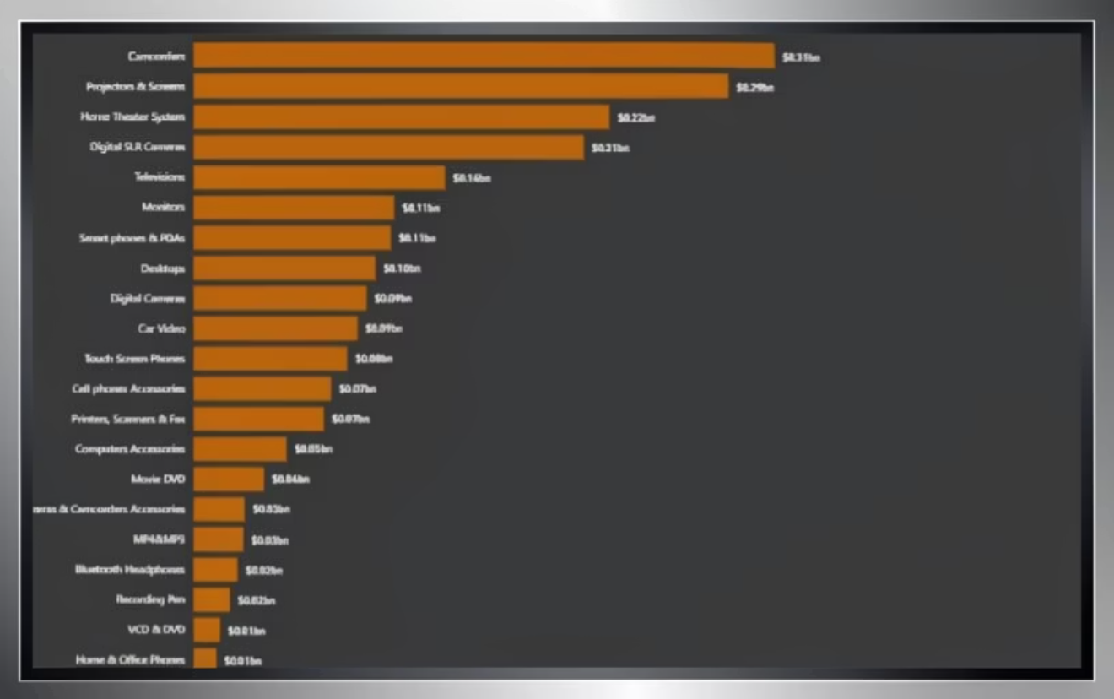
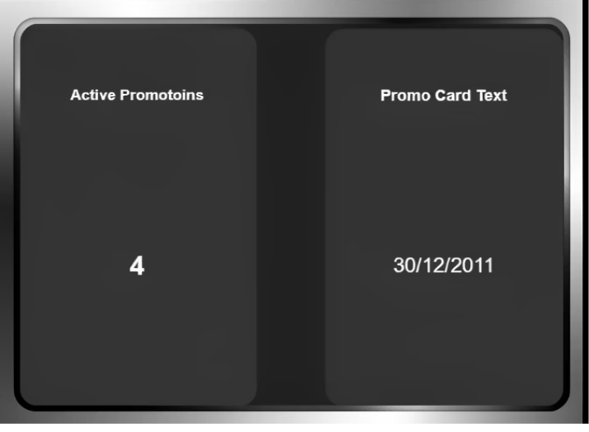
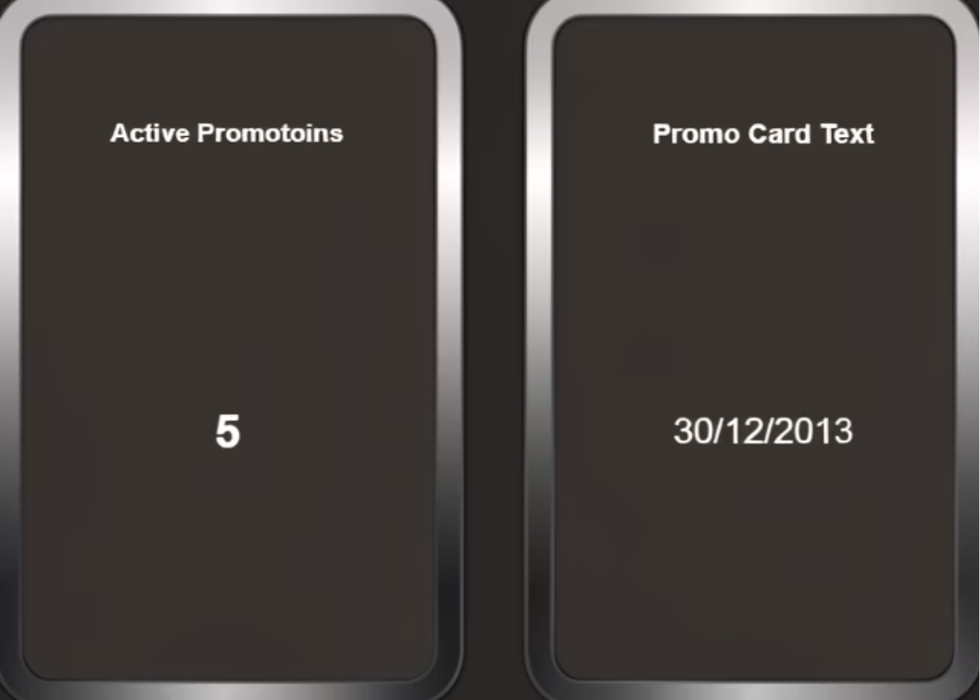
Category & Promotion Insights
Dynamic top 5 created a chart that displays the top 5 subcategories based on sales amount within the category that has the highest total sales. A dynamic DAX measure was used to calculate total sales, and a Top N (Top 5) filter was applied at the subcategory level. The visual was connected to the report slicers, allowing it to update dynamically based on user selections such as date, country, or category, ensuring an interactive and responsive analysis.
This analysis evaluates the impact of promotional activity on overall sales performance by comparing results between 2011 and 2013.In 2011, the company operated four active promotions and achieved higher revenue and profitability. However, in 2013, despite increasing the number of active promotions to five, both revenues declined by 3% and profit declined by 5%. This indicates that increasing promotional volume did not necessarily improve overall business performance, highlighting the importance of promotional effectiveness rather than quantity.

Slide 13

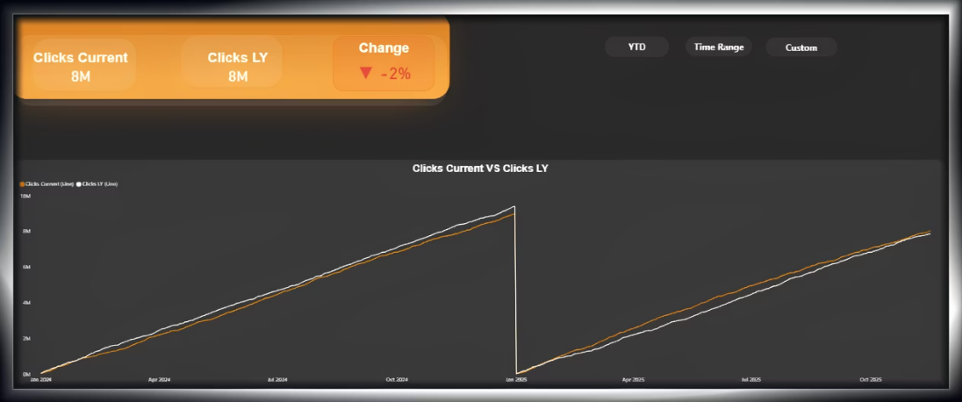
Advanced Time- Intelligence Analysis
This dashboard enables dynamic time-based analysis for marketing performance using three calculation modes: YTD, Rolling Time Range, and Custom Period comparison.Users can switch between time logics using interactive buttons. The dashboard dynamically updates Current Clicks, Last Year Clicks, Percentage Change, directional indicators, and a trend line visualization. This approach provides flexible and executive-level insight into marketing performance over time.

Slide 14

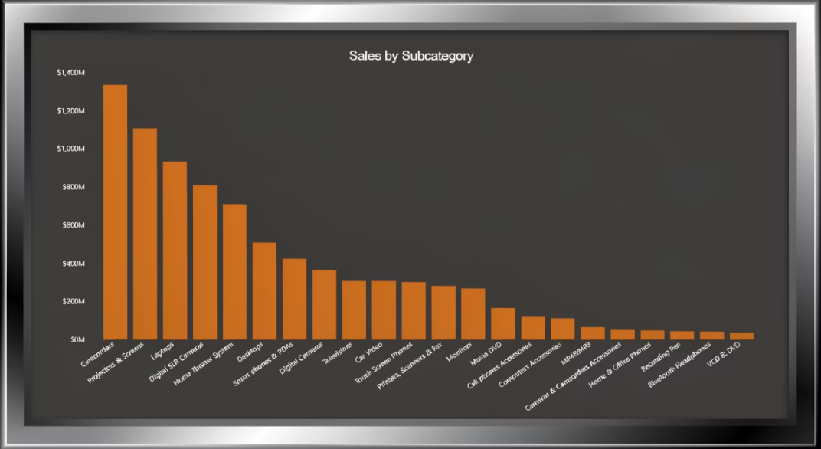
Data Security & Access Control (RLS)
Implementing a robust Row-Level Security (RLS) framework to ensure data confidentiality and integrity. The system dynamically filters data based on user roles, granting Regional Managers access only to their specific territories while maintaining a centralized, secure view for executive leadership.

Slide 15
Recommendations & Future Actions
Promotion Impact (2011 vs 2013)
The analysis indicates that increasing the number of promotions does not necessarily lead to higher revenue or profitability. Therefore, management should focus on designing targeted, high-impact promotional campaigns rather than increasing promotional volume. Future actions should include analyzing customer response behavior, measuring campaign ROI, and optimizing promotional cost efficiency to ensure sustainable revenue growth.
KPI Regional Comparison (Asia vs North America – 2013)
Since KPI underperformance appears to be region-specific, management should conduct a detailed regional performance review for North America. Future actions should include benchmarking North America against Asia, improving cost control strategies, reassessing pricing policies, and identifying operational inefficiencies affecting profitability and margin performance.
Dynamic Time Intelligence
Marketing performance varies depending on the selected time perspective. Therefore, decision-makers should evaluate both short-term and long-term performance trends before taking strategic action. Future actions should include deeper investigation of negative custom-period results, continuous monitoring of rolling trends, and aligning marketing strategies with long-term growth objectives.

